Slide 1


Advanced Message Queuing Protocol (AMQP)

Slide 2
Advanced Message Queuing Protocol
Why should you care ?
Many significant IT efforts include a messaging and integration component (10%-30% of project cost) .

Slide 3
Why Messaging ?
Transfer data from point A to point B.
Asynchronous.
Decouple publishers and consumers.
Queuing for later delivery.

Slide 4
Limitations of exiting MOMs
Proprietary middleware has been a source of lock-in.
IBM MQ, Tibco Rendezvous , Sonic MQ.
Interoperability is more difficult than it need be.
MQ Series and Tibco RV cannot natively interoperate with each other or other middleware products.
Language and platform independence is still an issue.
JMS is not technology agnostic and only legitimately supports Java platforms.

Slide 5
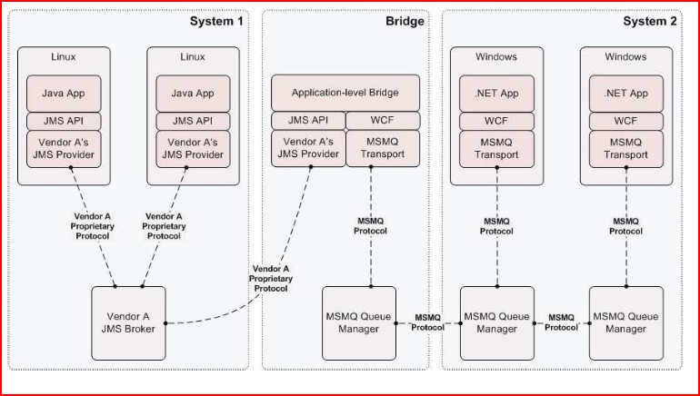
Application Level Bridging

Slide 6
AMQP
Conceived by JP Morgan around 2006.
Goal was to provide a vendor-neutral protocol for managing the flow of messages across enterprise's business systems.

Slide 7
How does AMQP solve the problem?
AMQP is a wire level protocol and not an API.
JMS is an API.
Just like HTTP is for Internet, AMQP is for messaging.
When a protocol is specified at the wire-level and published, most technologies can use it.
Compare this to an API, where the actual implementation is specific to the platform.

Slide 8
AMQP : Industry Support
Cisco Systems
Goldman Sachs
IONA
Novell
Redhat
WSO2
Microsoft
Credit Suisse
Envoy Technologies
iMatix
JPMorgan Chase
Rabbit Technologies
TWIST
29West

Slide 9
AMQP Concepts

Slide 10
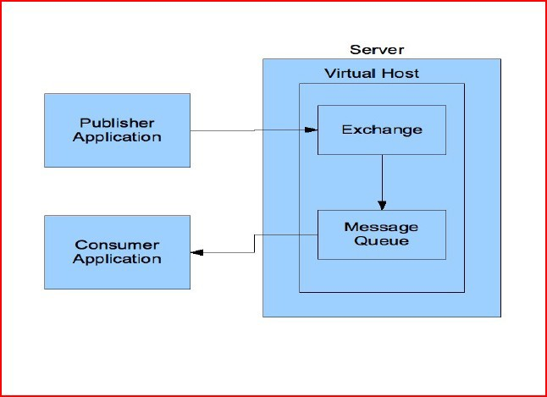
Virtual Hosts

Slide 11
Virtual Hosts
Each virtual host comprises its own name space, a set of exchanges, message queues and all associated objects.

Slide 12
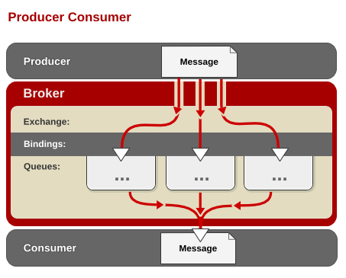
AMQP concepts

Slide 13
Exchange, Binding and Queues
The "exchange" receives messages from publisher and routes these to “Queues".
The "binding" defines the relationship between a message queue and an exchange and provides the message routing criteria.

Slide 14
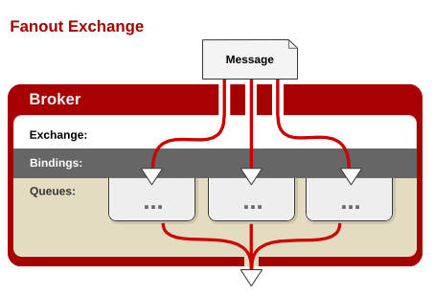
Exchange Types
A Fanout exchange sends messages to every queue bound to the exchange

Slide 15
Fanout Exchange Type
No routing key.
What goes in must go out.

Slide 16
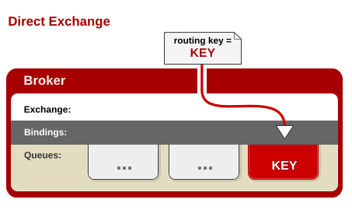
Exchange Types
A Direct exchange sends a message to a queue if the message's routing key is identical to the binding key for the queue.

Slide 17
Direct Exchange Type
Uses String as routing key.
Queue binds to exchange with key K.
Publisher sends a message with key R.
Message is passed to this queue if K=R.
Direct exchange named “amq.direct” is always pre-created in each virtual host

Slide 18
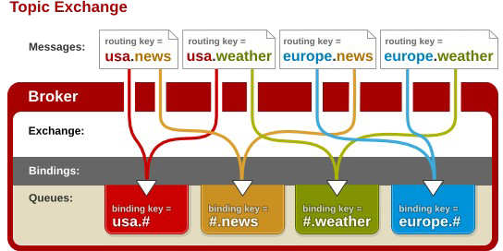
Exchange Types

Slide 19
Topic Exchange Type
Uses pattern as routing key (“a.b.c.d”).
Queues can use wildcard characters in binding key.
* matches a single word.
# matches zero or more words.
“amq.topic” is pre-created in each virtual host.
*.stock.# matches usd.stock and eur.stock.db but not stock.nasdaq

Slide 20
AMQP Broker Implementations
Apache Qpid : http://qpid.apache.org
◻ Java & C++ Implementation.
Rabbit MQ : http://www.rabbitmq.com
◻Erlang Implementation.
Red Hat's MRG (Messaging, Realtime & Grid) : http://www.redhat.com/mrg/
◻C++ Implementation.

Slide 21
Apache Qpid: Open Source AMQP Messaging
AMQP Messaging Brokers
C++ implementation
Java implementation
AMQP Client APIs: C++, Java, JMS, Ruby, Python, and C#

